Slide 1

Project Title –Healthcare Analytics for Doctor Visits TIRTC
TRIPTI
AICTE ID: STU682da7bfce37f1747822527

Slide 2

PROBLEM STATEMENT
Healthcare data contains valuable information about patients, including their illness, hospital visits, income, gender, insurance coverage, and activity limitations. However, it can be difficult to identify meaningful patterns from raw data.
This project focuses on analysing healthcare data to understand:
Factors related to hospital visits
The relationship between income and healthcare utilization
Differences in illness impact across male and female patients
Government and private health insurance coverage
The effect of illness on daily activities

Slide 3
Project Description
Healthcare Analytics – Analysis of Doctor Visits is a data analysis project that explores patient health and healthcare utilization patterns.
The project uses Exploratory Data Analysis (EDA), statistical analysis, and data visualization to study patient demographics, income, illness, hospital visits, insurance coverage, and reduced activity due to illness.
The analysis helps transform healthcare data into meaningful insights that can support better understanding and planning of healthcare services.

Slide 4

WHO ARE THE END USERS?
Healthcare Providers – To understand patient visit patterns and illness-related activity limitations.
Hospitals & Healthcare Administrators – To analyse patient demographics and healthcare utilization.
Health Insurance Organizations – To understand insurance coverage patterns.
Government Health Departments – To study healthcare coverage among low-income and elderly populations.
Healthcare Data Analysts – To identify relationships between income, illness, insurance, and hospital visits.
Overall Goal: Support data-driven healthcare planning and decision-making.

Slide 5

Technology Used
Programming & Analysis
Python – Data processing and analysis
Pandas – Data manipulation and analysis
NumPy – Numerical calculations
Visualization
Matplotlib – Creating charts and graphs
Seaborn – Statistical data visualization
Development Environment
Jupyter Notebook – Project development and analysis

Slide 6
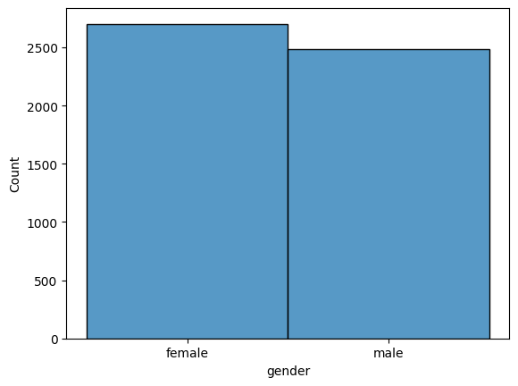
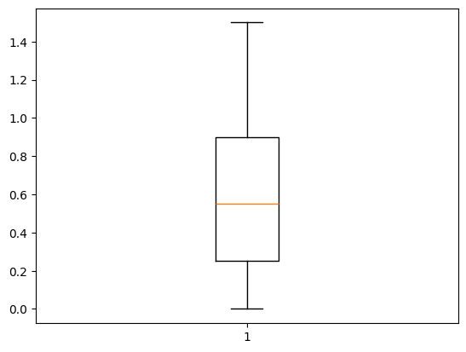
RESULTS
[Add screen shots of your code ]
Demo Link

Slide 7
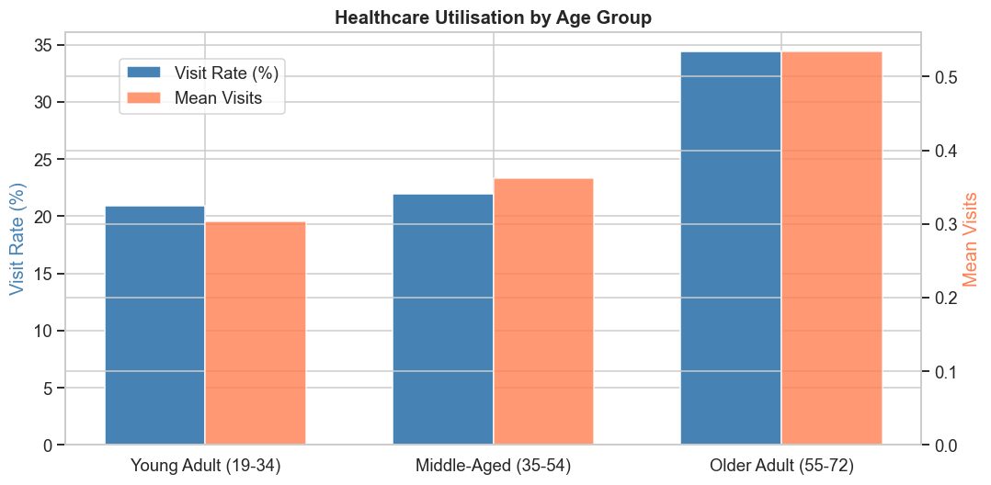
RESULTS
[Add screen shots of your code ]

Slide 8
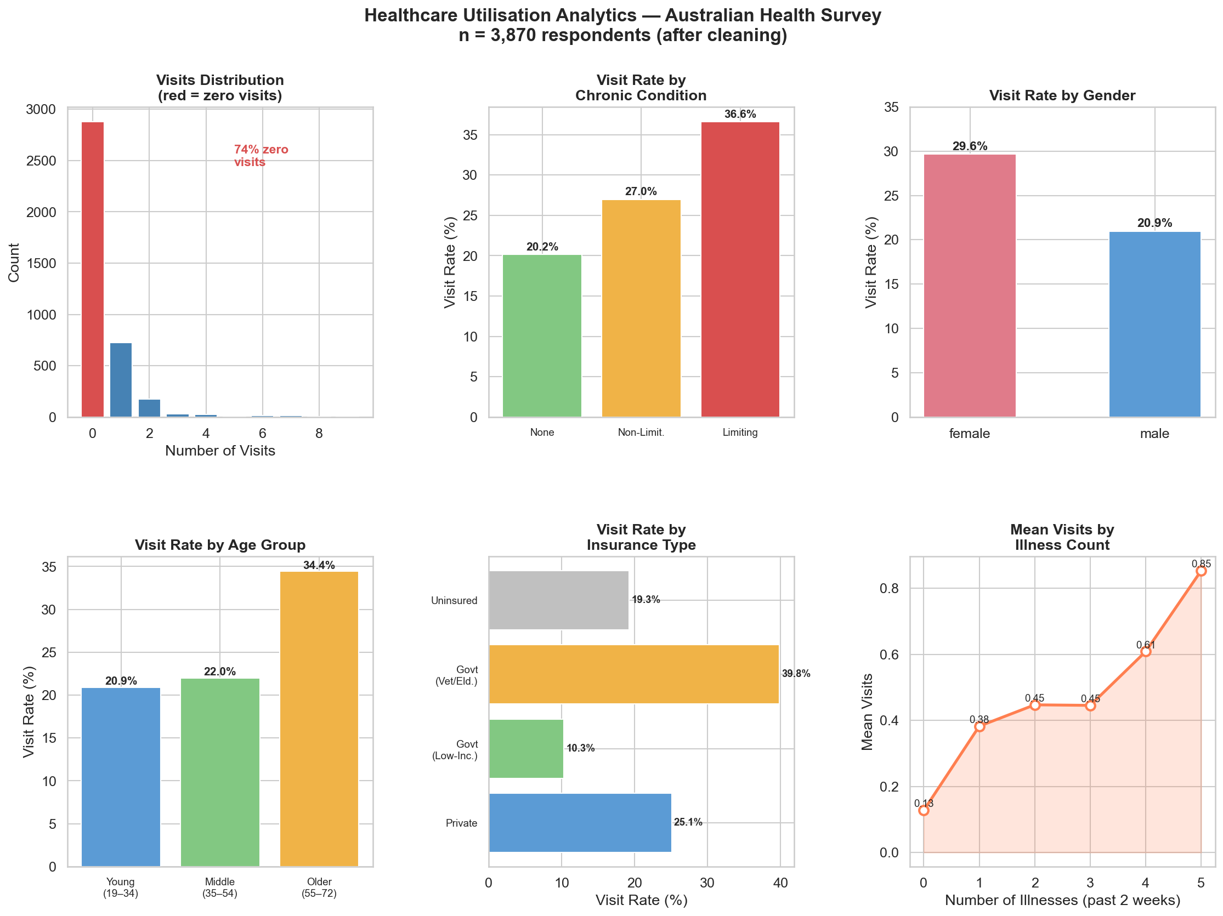
RESULTS
[Add screen shots of your code ]

Slide 9
Thank you
.
.

